Slide 1
New Investigator Collaborations and Interactions from an Industry Perspective
Marie-Christine Phan, PharmD
Medical Affairs Scientist, Pipeline
August 2024

Slide 2
Disclaimer
This presentation may contain information related to Pfizer products, not included in the Canadian Product Monograph (labelling), or which do not have a marketing authorization. This may include information on medicines in development. This information is being provided for non-promotional purposes.
The content of this presentation is considered by Pfizer Canada Medical to be truthful, accurate, balanced, fair, not misleading and supported by relevant scientific data, including safety data. It is tailored to answer the specific question asked. Pfizer colleagues are required to document the request for this meeting/information and communication of the relevant information.
Marie-Christine Phan is an employee of Pfizer Canada. In line with the Innovative Medicines Canada (IMC) Code of Ethical Practices, this presentation represents a scientific exchange as opposed to a learning activity.

Slide 3
Types of Collaborations for Research
Research
Company-Sponsored Clinical Trials
Independent Initiatives

Slide 4
Types of Collaborations for Research
Research
Company-Sponsored Clinical Trials
Independent Initiatives

Slide 5
Canadian Contribution to Pfizer R&D
*Data as of February 2024.

Slide 6
Pfizer Oncology Journey in Canada
2024
2006
2012
2020
2021
2019
2018
2017
# Approved Medicines
(all assets)
2016
2014
# Approved Indications (innovative assets)
19
2007
21

Slide 7
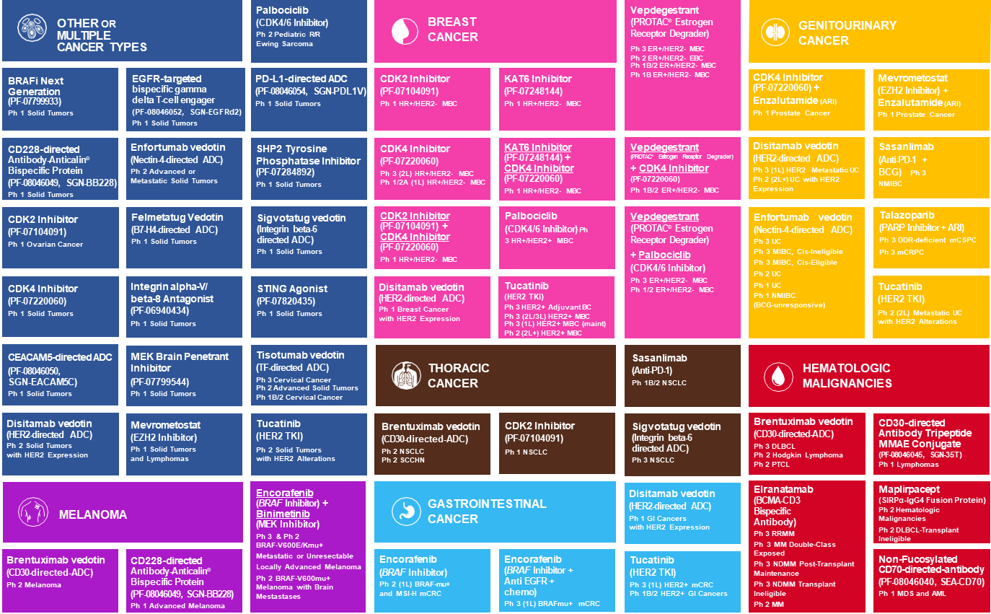
Efficacy and safety of these products, for the uses identified within, are currently under investigation.
Regulatory approval of any of these products or uses is dependent on the completion of the study programs and review by regulatory authorities. The clinical trial information is available at www.clinicaltrials.gov. This information is current as of June, 2024.
Anticalin® is a registered US trademark of Pieris Pharmaceuticals Gmbh

Slide 8
OTHER OR MULTIPLE CANCER TYPES
Palbociclib (CDK4/6 Inhibitor) Ph 2 Pediatric R/R Ewing Sarcoma
BREAST CANCER
Vepdegestrant (PROTAC® Estrogen Receptor Degrader)
Ph 3 ER+/HER2- MBC Ph 2 ER+/HER2- EBC
Ph 1B/2 ER+/HER2- MBC
Ph 1B ER+/HER2- MBC
GENITOURINARY CANCER
BRAFi Next Generation (PF-07799933)
Ph 1 Solid Tumors
EGFR-targeted bispecific gamma delta T-cell engager
(PF-08046052, SGN-EGFRd2)
Ph 1 Solid Tumors
PD-L1-directed ADC
(PF-08046054, SGN-PDL1V)
Ph 1 Solid Tumors
CDK2 Inhibitor
(PF-07104091)
Ph 1 HR+/HER2- MBC
KAT6 Inhibitor
(PF-07248144)
Ph 1 HR+/HER2- MBC
CDK4 Inhibitor
(PF-07220060) +
Enzalutamide (ARI) Ph 1 Prostate Cancer
Mevrometostat (EZH2 Inhibitor) + Enzalutamide (ARI) Ph 1 Prostate Cancer
CD228-directed Antibody-Anticalin® Bispecific Protein
(PF-08046049, SGN-BB228)
Ph 1 Solid Tumors
Enfortumab vedotin (Nectin-4-directed ADC) Ph 2 Advanced or Metastatic Solid Tumors
SHP2 Tyrosine Phosphatase Inhibitor (PF-07284892)
Ph 1 Solid Tumors
CDK4 Inhibitor
(PF-07220060)
Ph 3 (2L) HR+/HER2- MBC
Ph 1/2A (1L) HR+/HER2- MBC
KAT6 Inhibitor
(PF-07248144) +
CDK4 Inhibitor
(PF-07220060)
Ph 1 HR+/HER2- MBC
Vepdegestrant
(PROTAC® Estrogen Receptor Degrader)
+ CDK4 Inhibitor
(PF-07220060)
Ph 1B/2 ER+/HER2- MBC
Disitamab vedotin
(HER2-directed ADC)
Ph 3 (1L) HER2 Metastatic UC Ph 2 (2L+) UC with HER2
Expression
Sasanlimab (Anti-PD-1 + BCG) Ph 3 NMIBC
CDK2 Inhibitor
(PF-07104091)
Ph 1 Ovarian Cancer
Felmetatug Vedotin (B7-H4-directed ADC) Ph 1 Solid Tumors
Sigvotatug vedotin (Integrin beta-6 directed ADC)
Ph 1 Solid Tumors
CDK2 Inhibitor
(PF-07104091) +
CDK4 Inhibitor
(PF-07220060)
Ph 1 HR+/HER2- MBC
Palbociclib (CDK4/6 Inhibitor) Ph 3 HR+/HER2+ MBC
Vepdegestrant (PROTAC® Estrogen Receptor Degrader)
+ Palbociclib
(CDK4/6 Inhibitor)
Ph 3 ER+/HER2- MBC Ph 1/2 ER+/HER2- MBC
Enfortumab vedotin (Nectin-4-directed ADC) Ph 3 UC
Ph 3 MIBC, Cis-Ineligible Ph 3 MIBC, Cis-Eligible Ph 2 UC
Ph 1 UC
Ph 1 NMIBC
(BCG-unresponsive)
Talazoparib
(PARP Inhibitor + ARI)
Ph 3 DDR-deficient mCSPC Ph 3 mCRPC
CDK4 Inhibitor
(PF-07220060)
Ph 1 Solid Tumors
Integrin alpha-V/ beta-8 Antagonist (PF-06940434)
Ph 1 Solid Tumors
STING Agonist
(PF-07820435)
Ph 1 Solid Tumors
Disitamab vedotin
(HER2-directed ADC) Ph 1 Breast Cancer with HER2 Expression
Tucatinib
(HER2 TKI)
Ph 3 HER2+ Adjuvant BC Ph 3 (2L/3L) HER2+ MBC
Ph 3 (1L) HER2+ MBC (maint)
Ph 2 (2L+) HER2+ MBC
Tucatinib
(HER2 TKI)
Ph 2 (2L) Metastatic UC with HER2 Alterations
Efficacy and safety of these products, for the uses identified within, are currently under investigation.
Regulatory approval of any of these products or uses is dependent on the completion of the study programs and review by regulatory authorities. The clinical trial information is available at www.clinicaltrials.gov. This information is current as of June, 2024.
CEACAM5-directed ADC
(PF-08046050, SGN-EACAM5C)
Ph 1 Solid Tumors
MEK Brain Penetrant Inhibitor
(PF-07799544)
Ph 1 Solid Tumors
Tisotumab vedotin
(TF-directed ADC)
Ph 3 Cervical Cancer
Ph 2 Advanced Solid Tumors Ph 1B/2 Cervical Cancer
THORACIC CANCER
Sasanlimab
(Anti-PD-1)
Ph 1B/2 NSCLC
HEMATOLOGIC MALIGNANCIES
Disitamab vedotin
(HER2-directed ADC) Ph 2 Solid Tumors with HER2 Expression
Mevrometostat
(EZH2 Inhibitor)
Ph 1 Solid Tumors and Lymphomas
Tucatinib
(HER2 TKI)
Ph 2 Solid Tumors with HER2 Alterations
Brentuximab vedotin
(CD30-directed-ADC)
Ph 2 NSCLC
Ph 2 SCCHN
CDK2 Inhibitor
(PF-07104091)
Ph 1 NSCLC
Sigvotatug vedotin (Integrin beta-6 directed ADC)
Ph 3 NSCLC
Brentuximab vedotin
(CD30-directed-ADC)
Ph 3 DLBCL
Ph 2 Hodgkin Lymphoma Ph 2 PTCL
CD30-directed Antibody Tripeptide MMAE Conjugate
(PF-08046045, SGN-35T)
Ph 1 Lymphomas
MELANOMA
Encorafenib (BRAF Inhibitor) + Binimetinib (MEK Inhibitor)
Ph 3 & Ph 2
BRAF-V600E/Kmu+
GASTROINTESTINAL CANCER
Disitamab vedotin
(HER2-directed ADC)
Ph 1 GI Cancers
with HER2 Expression
Elranatamab (BCMA-CD3 Bispecific Antibody)
Ph 3 RRMM
Ph 3 MM Double-Class Exposed
Ph 3 NDMM Post-Transplant Maintenance
Ph 3 NDMM Transplant Ineligible
Ph 2 MM
Maplirpacept
(SIRPα-IgG4 Fusion Protein) Ph 2 Hematologic Malignancies
Ph 2 DLBCL-Transplant Ineligible
Anticalin® is a registered US trademark
of Pieris Pharmaceuticals Gmbh
Brentuximab vedotin
(CD30-directed-ADC)
Ph 2 Melanoma
CD228-directed Antibody-Anticalin® Bispecific Protein
(PF-08046049, SGN-BB228)
Ph 1 Advanced Melanoma
Metastatic or Unresectable
Encorafenib (BRAF Inhibitor) Ph 2 (1L) BRAF-mu+
and MSI-H mCRC
Encorafenib (BRAF Inhibitor + Anti EGFR + chemo)
Ph 3 (1L) BRAFmu+ mCRC
Tucatinib
(HER2 TKI)
Ph 3 (1L) HER2+ mCRC
Ph 1B/2 HER2+ GI Cancers
Non-Fucosylated
CD70-directed-antibody
(PF-08046040, SEA-CD70)
Ph 1 MDS and AML
Locally Advanced Melanoma
Ph 2 BRAF-V600mu+
Melanoma with Brain Mestastases

Slide 9
Company-Sponsored Clinical Trial
Implementation Steps
Country Outreach
Site Nomination
Site
Selection
Feasibility

Slide 10
Becoming an Investigator
The advancement of medicine relies on dedicated clinical trial partners. If you are interested in working with Pfizer as an investigator, please send your contact details, institution or site name, and therapeutic areas of interest to
clinicaltrials@pfizer.com

Slide 11
Pfizer Investigator Training Program

Slide 12
Types of Collaborations for Research
Research
Company-Sponsored Clinical Trials
Independent Initiatives

Slide 13
Independent Initiatives
Pfizer supports the global healthcare community’s independent initiatives (e.g., research, quality improvement, or education) to improve patient outcomes in areas of unmet medical need that are aligned with Pfizer’s areas of interest.
Types of initiatives include, but are not limited to:
Investigator-Sponsored Research (ISR): A grant that supports an independent research study where the investigator or organization is the sponsor of the study and where Pfizer provides financial and/or non-financial support for the development or refinement of specific and defined medical knowledge relating to a Pfizer asset.
General Research: This grant type is used to support research that does not include the study of a Pfizer asset, including health services research unrelated to a Pfizer asset, registry development and/or queries unrelated to a Pfizer asset, and outcomes research unrelated to a Pfizer asset.
Quality Improvement (QI): Type of grant which consists of Pfizer funding to support independent projects for systematic and continuous actions that lead to measurable improvement in health care services and the health status of individuals and targeted patient groups and do not relate to a Pfizer asset.
Research Collaboration: Type of study where the investigator acts as the sponsor, but Pfizer is involved in any of the following elements: designing, implementing, conducting, monitoring, and/or oversight of the research; can be international or non-interventional.
Competitive Grants Program (or Request for Proposals): Pfizer’s competitive grant program involves a publicly posted Request for Proposal (RFP) that provides detail regarding a specific area of interest and sets timelines for review and approval. Organizations are invited to submit an application addressing the specific gaps in research, practice or care as outlined in the specific RFP.
Pfizer Independent Health Education Grants and Resources Center | Pfizer Independent Grants | Pfizer

Slide 14
Request for Proposals (Past)

Slide 15
Thank you!
Marie-Christine Phan
marie-christine.phan@pfizer.com

